Slide 1
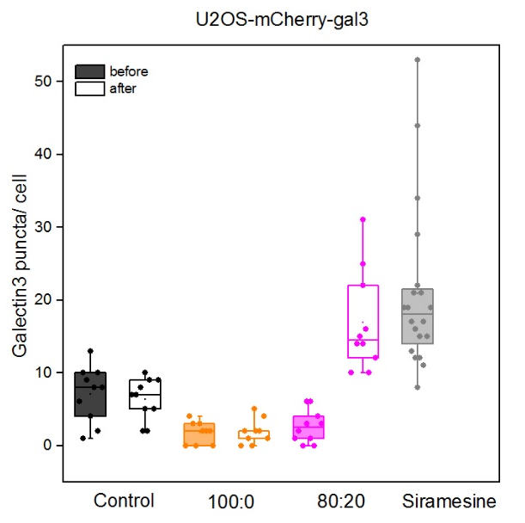
Detection of lysosomal permeabilization by using galectin puncta assay
Control
100:0
80:20
Siramesine
before
after
10 μm
MCF7-mAG-gal3

